Slide 1
Probability Calculator and Hypothesis Tester: A Comprehensive Statistical Toolkit
IE509 (Computation and Programming Lab)
Prof. Urban Larsson & Balamurugan Palaniappan
Sarvesh Maurya
24N0465
Goutam Agarwal
24N0463

Slide 2
Motivation and Background
The idea for this feature stems from my undergraduate studies when we used to manually refer to Z-tables and t-tables for finding probabilities and critical values during hypothesis testing. We thought, 'Why not use Python programming to simplify this process

Slide 3
Introduction
This project is divided into two main parts:
Part 1: Probability Calculations with Visualizations
Provides various types of probability distributions (e.g., normal, binomial, Poisson,), allowing users to select parameters and distribution types.
Visualizes each distribution with shaded areas, highlighting specific probability regions for a clearer understanding.
Part 2: Hypothesis Testing and Data Analysis
Accepts data input manually or from CSV.
Offers three test options: one-sample t-test, two-sample t-test, and z-test, with assumption checks.
Includes outlier detection, descriptive statistics (mean, variance, etc.), and data visualization.
Outputs the test results, comparing the p-value with the significance level, and displays a confidence interval for the results.

Slide 4
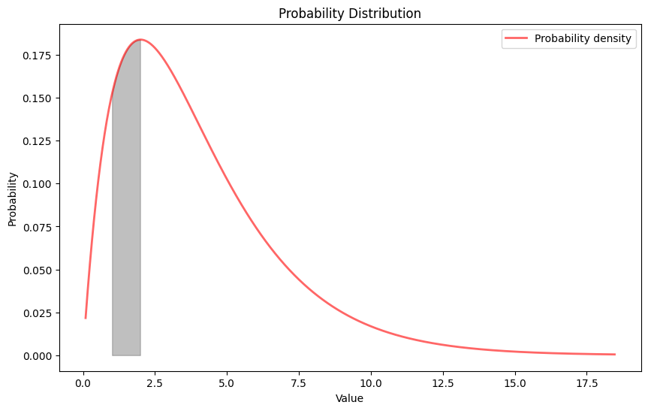
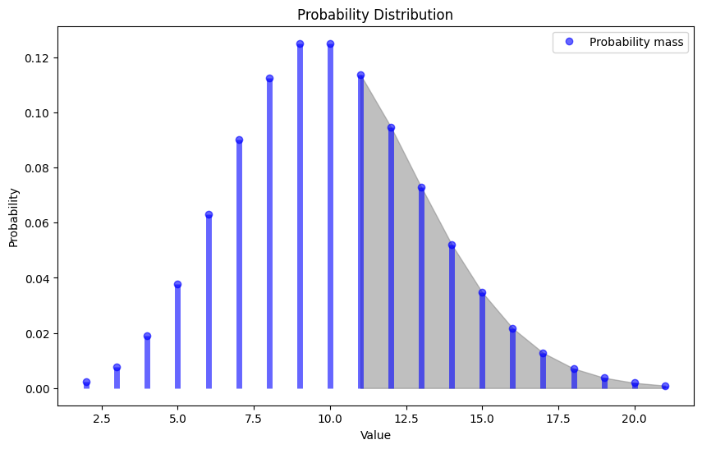
Probability Calculations with Visualizations
You can calculate probability from both discrete and continuous distributions (Binomial, Poisson, Geometric, Exponential, Normal, Uniform, Gamma, Chi-square)
The code is written like this, After selecting the distribution it will ask appropriate parameters for the chosen distribution.
It will also ask what type of probability do you want to calculate like P(X<x) P(X>x) or P(a<X<b).
It will return you the appropriate probability and shaded region.

Slide 5
Usability and Key Features – Probability Calculations
This project’s first part combines all essential probability distributions in one place:
Unified Distribution Options: All types of distributions (normal, binomial, Poisson, etc.) are available in a single platform.
Simplifies Code: No need to write separate code for each distribution; all calculations and visualizations are integrated, saving time and reducing complexity.
Automatic Visualizations: Visualizations with shaded areas make it easy to interpret probabilities without consulting separate tables (e.g., normal or chi-square tables).
Academic Applications: Ideal for academic purposes, providing a ready-to-use tool for understanding and exploring various probability distributions."

Slide 6
Hypothesis Testing and Data Analysis
The second half of this project streamlines hypothesis testing by automating key steps in the process:
Data Input
User provides data either manually or by uploading a CSV file.
Column Selection
Specific columns are selected for hypothesis testing, allowing for targeted analysis.
Null Value Removal
Automatically detects and removes any null (missing) values to ensure clean, usable data.
Assumption Checks
Verifies essential assumptions (e.g., normality, homogeneity of variance) for the chosen test, ensuring validity.
Hypothesis Test Selection
User selects the appropriate test: one-sample t-test, two-sample t-test, or z-test, based on the research question.
Hypothesis Testing
The test is conducted, and the p-value is calculated.
Compare p-value with Significance Level
The p-value is compared to the significance level (α) to decide whether to reject or fail to reject the null hypothesis.
Confidence Interval Visualization
Displays a confidence interval around the sample mean or difference, providing a visual summary of the test results.
Results Interpretation
Presents a summary of findings, including confidence intervals and the final statistical decision

Slide 7
Internal working of the the programme
Data Input and Validation
The program first allows the user to enter data manually or upload a CSV file.
After data is loaded, specific columns are selected based on the user’s analysis needs.
The program validates the data to ensure it’s in the correct format, handling any errors in data types or structure.
Null Value Detection and Removal
Checks for any missing (null) values within the dataset.
Automatically removes null values to ensure accurate calculations and reliable results in subsequent .steps
Outlier Detection
Automatically detects and removes outliers from the dataset, ensuring a clean and accurate analysis by using box plot

Slide 8
Assumption Checks
Based on the test selected, the program runs necessary assumption checks:
Normality Check: Uses statistical tests like the Shapiro-Wilk test to check if data follows a normal distribution.
Variance Equality (for two-sample tests): For two-sample tests, it uses tests like Levene’s to ensure the variances of groups are comparable.
If assumptions are violated, the program may suggest alternatives or warn the user, ensuring valid and appropriate test results.
Hypothesis Test Execution
Executes the selected test (one-sample t-test, two-sample t-test, or z-test).
Calculates the test statistic and p-value, which are central to determining the outcome of the hypothesis test.
Confidence interval visual
Provides a visual representation of the confidence interval around the mean, offering insight into the range of values likely to contain the true population parameter.

Slide 9
Usability and Key Features – Part 2: Hypothesis Testing
Flexible Data Input: Users can input data manually or via CSV files, and can select the column on which he/she wants to perform test
Automated Assumptions Checking: Assumptions for each test (e.g., normality, variance equality) are checked automatically, avoiding the need for extra code.
Saves Time: By streamlining assumption checks and offering multiple test options, this project helps users avoid redundant code.
Versatile and Practical: Simplifies hypothesis testing workflows, making it practical for academic and research applications where quick and reliable statistical insights are needed.

Slide 10
Methodology and Concept used in this project
Throughout this project, We have made use of the key concepts we have learned in the lab, including:
Object-Oriented Programming (OOP): We designed the program in a modular way, using classes and objects to handle different distributions and statistical functions.
Data Structures: Lists, dictionaries, and arrays are used to store user inputs and manage the flow of data within the program.
Python Libraries: The project leverages several powerful Python libraries, such as:
NumPy: For mathematical computations
Pandas: For data manipulation and analysis
Matplotlib and Seaborn: For generating visualizations
SciPy: For performing statistical tests and calculating probabilities

Slide 11
Q&A
Thank you! Any questions?

